Slide 1
Interprocess Communication IPC
Message Queues

Slide 2
Message Queues
An ordered list of messages held in the kernel
Is identified by a numeric key
It has ownership and access modes
It exists quite independently from any particular user process
Functionality is mid-way between pipes (FIFO) and shared memory (random)

Slide 3
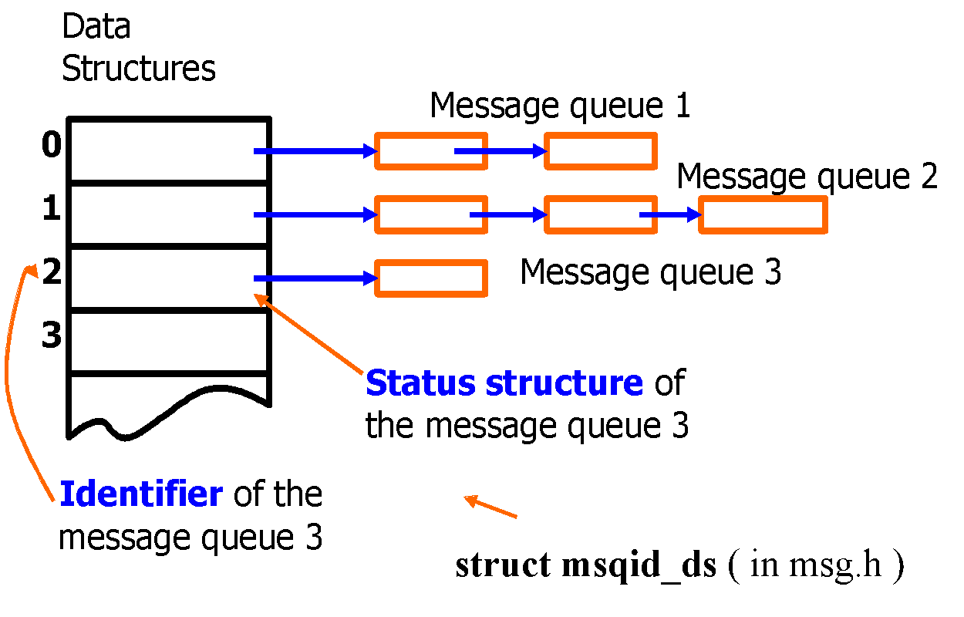
Message Queues Housekeeping

Slide 4
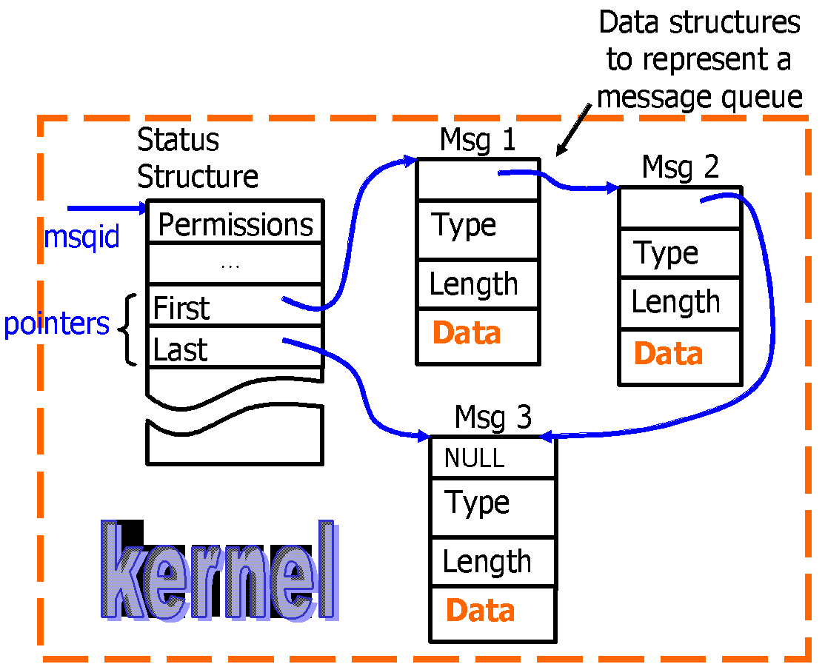
Detailed Message Queue

Slide 5
msqid_ds (in msg.h)
stuct msqid_ds
{
stuct ipc_perm msg_perm; /* opertion permission struct */
struct msg *msg_first; /* ptr to first message on q */
struct msg *msg_last; /* ptr to last message on q */
ushort msg_cbytes; /* current # bytes on q */
ushort msg_qnum; /* current # of messages on q */
ushort msg_qbytes /* max # of bytes allowed on q */
ushort msg_lspid; /* pid of last msgsnd */
ushort msg_lrpid; /* pid of last msgrcv */
time_t msg_stime; /* time of last msgsnd */
time_t msg_rtime; /* time of last msgrcv */
time_t msg_ctime; /* time of last msgct1 */
}

Slide 6
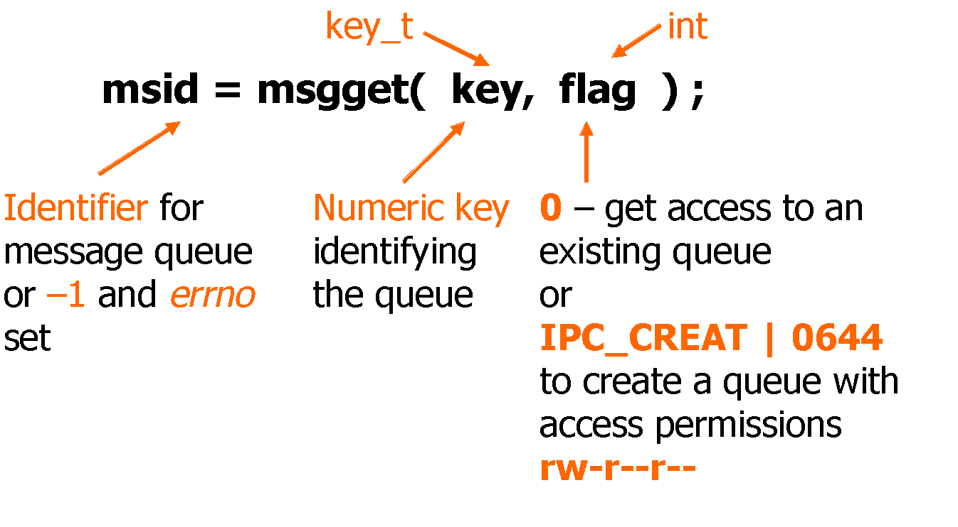
Related System Calls
Creating a message queue or getting access to an existing message queue:

Slide 7
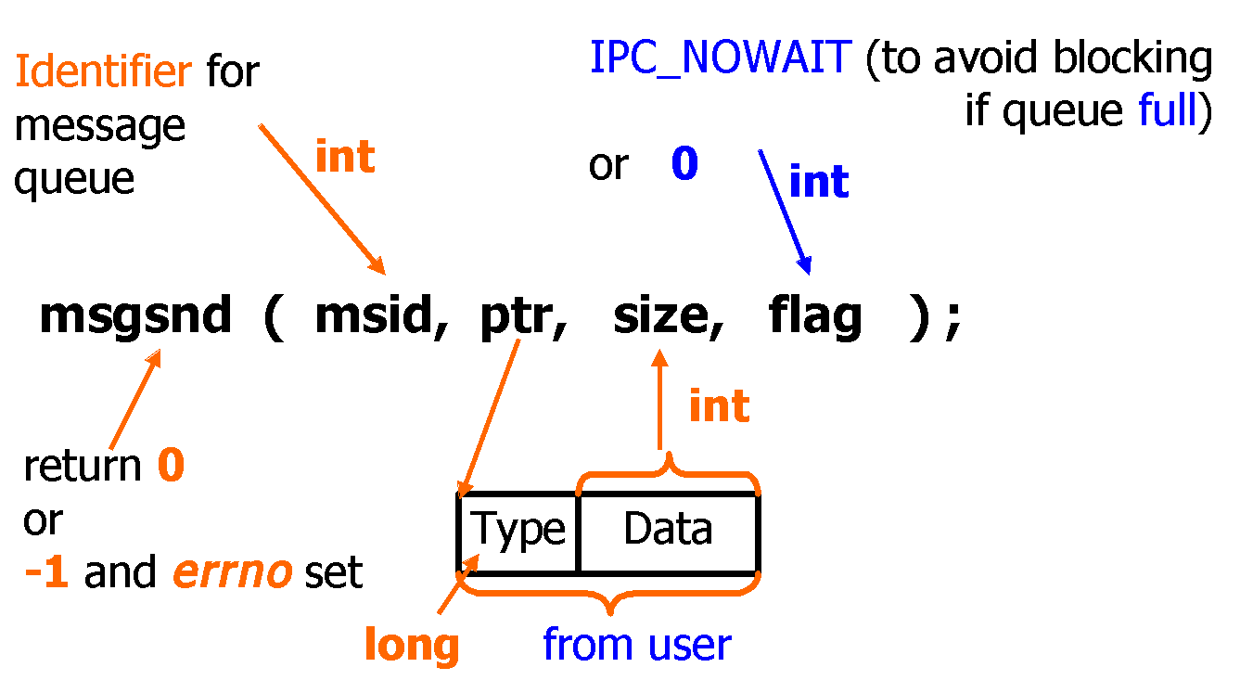
Related System Calls
Sending a message to a queue:

Slide 8
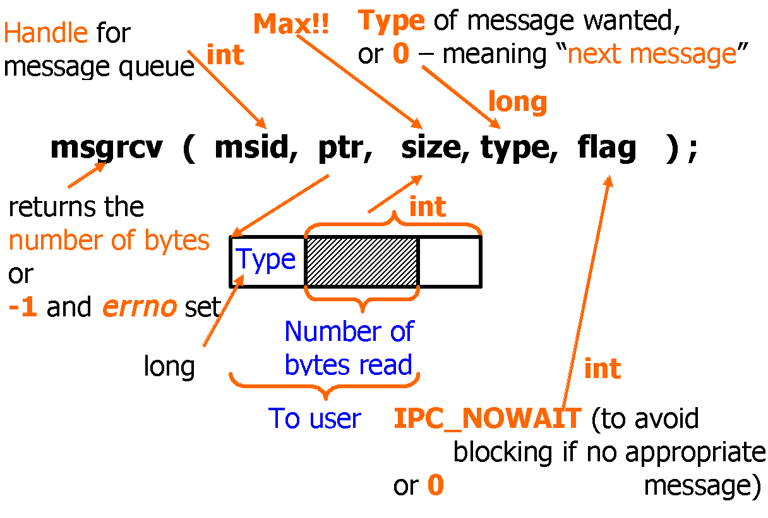
Related System Calls
Reading from a message queue (and removing the message)

Slide 9
Receiving a message
User has some control over the order of how messages are retrieved
Type: 0 → Next msg in Q
Type: +ve →gets the 1st msg of that type
Type: -ve →gets the 1st msg of the lowest type which is less than or equal to the absolute value of type

Slide 10
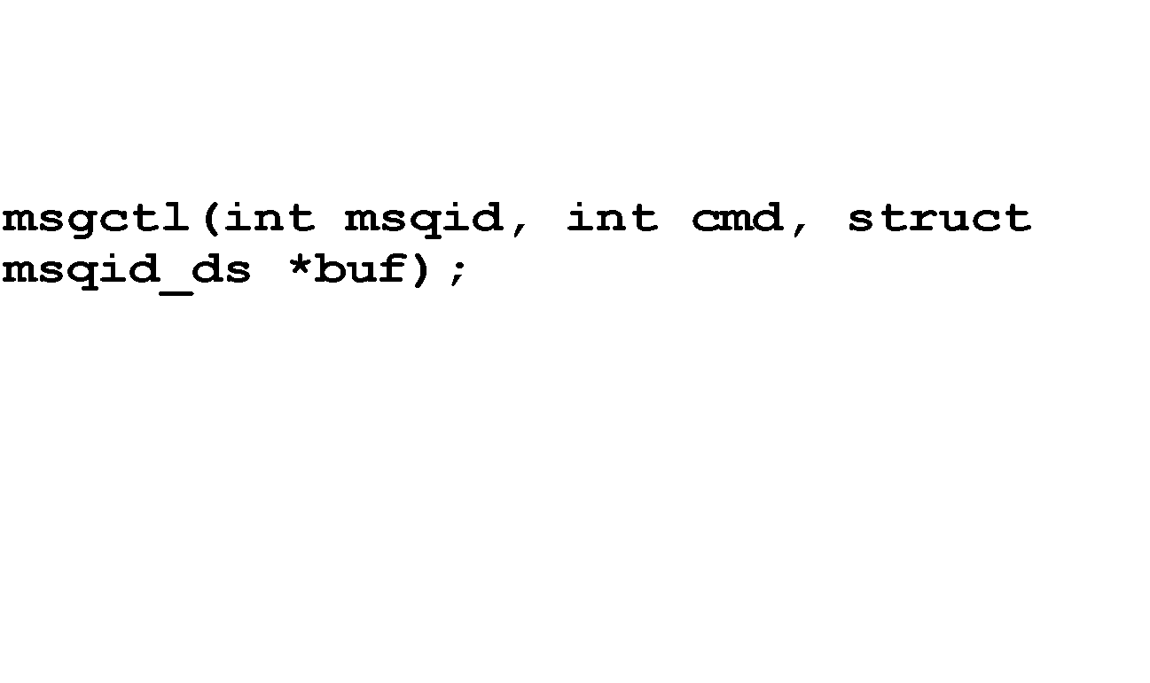
Deallocate or change permissions for the message queue:
Cmd:
IPC_RMID remove the message queue msqid and
destroy the corresponding msqid_ds
IPC_SET set members of the msqid_ds data
structure from buf
IPC_STAT copy members of the msqid_ds data
structure into buf

Slide 11
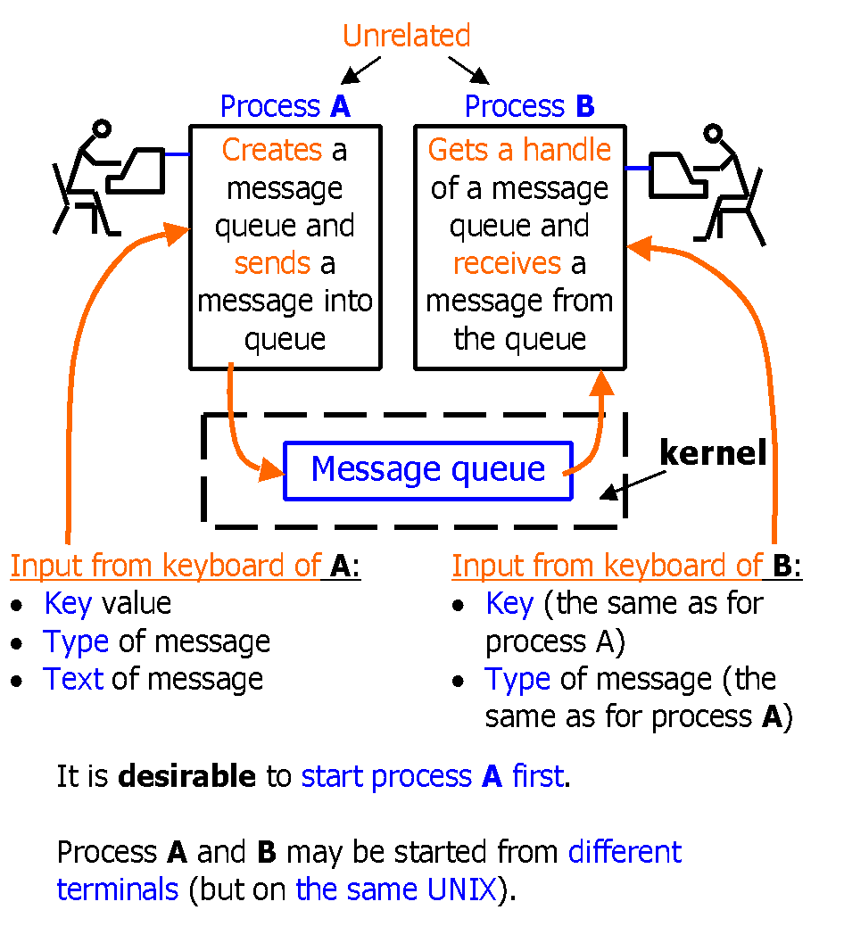
Example

Slide 12
Example: (Sender)
#include < … >
struct text_message {
long mtype ;
char mtext[100] ;
} ;
main(int argc, char *argv[]) /*usage :a.out <key><type><text>*/
{
int msid, v ;
struct text_message mess ;
/* Creating a message queue */
msid = msgget((key_t) atoi( argv[1] ), IPC_CREAT | 0666 );
if ( msid == -1)
{
… ;
exit(1) ;
}

Slide 13
/* Preparing a message */
mess.mtype = atoi( argv[2] ) ;
strcpy( mess.mtext, argv[3] ) ;
/* write a message onto queue */
v = msgsnd( msid, &mess, strlen( argv[3] ) + 1, 0 ) ;
if ( v < 0 )
{
error message …;
exit(0);
}
}
The result: Process has created a message queue, put one message onto the queue, and finished.

Slide 14
Example (Receiver)
#include < … >
struct text_message {
long mtype ;
char mtext[100];
} ;
main(int argc, char *argv[]) /* usage :a.out <key> <type> */
{
int msid, v ;
struct text_message mess ;
/* Get a message handle */
msid = msgget( (key_t) atoi( argv[1] ), 0 ) ;
if ( msid == -1) { … ; exit(1) ; }
/* Read a message of the given type */
v = msgrcv( msid, &mess, 100, atoi( argv[2] ), IPC_NOWAIT ) ;

Slide 15
if ( v < 0 )
{ error message and exit
}
else
printf(“%d %s\n”, mess.mtype, mess.mtext ) ;
/* Remove the message queue from UNIX */
msgctl( msid, IPC_RMID, 0 ) ; exit(0) ;
}
The result: The process got a message queue identifier, read the message from the queue, and removed the message queue.

